Slide 1
Welcome to LS 591!

Slide 2
Agenda
Pizza + Ice Breaker!
Course Overview
Departmental Values
Activity & Discussion
Discord Access, GitHub Accounts

Slide 3

Tell us about yourself
Name
Song that you would like to listen to
Favorite ice cream flavor
random fun fact?

Slide 4
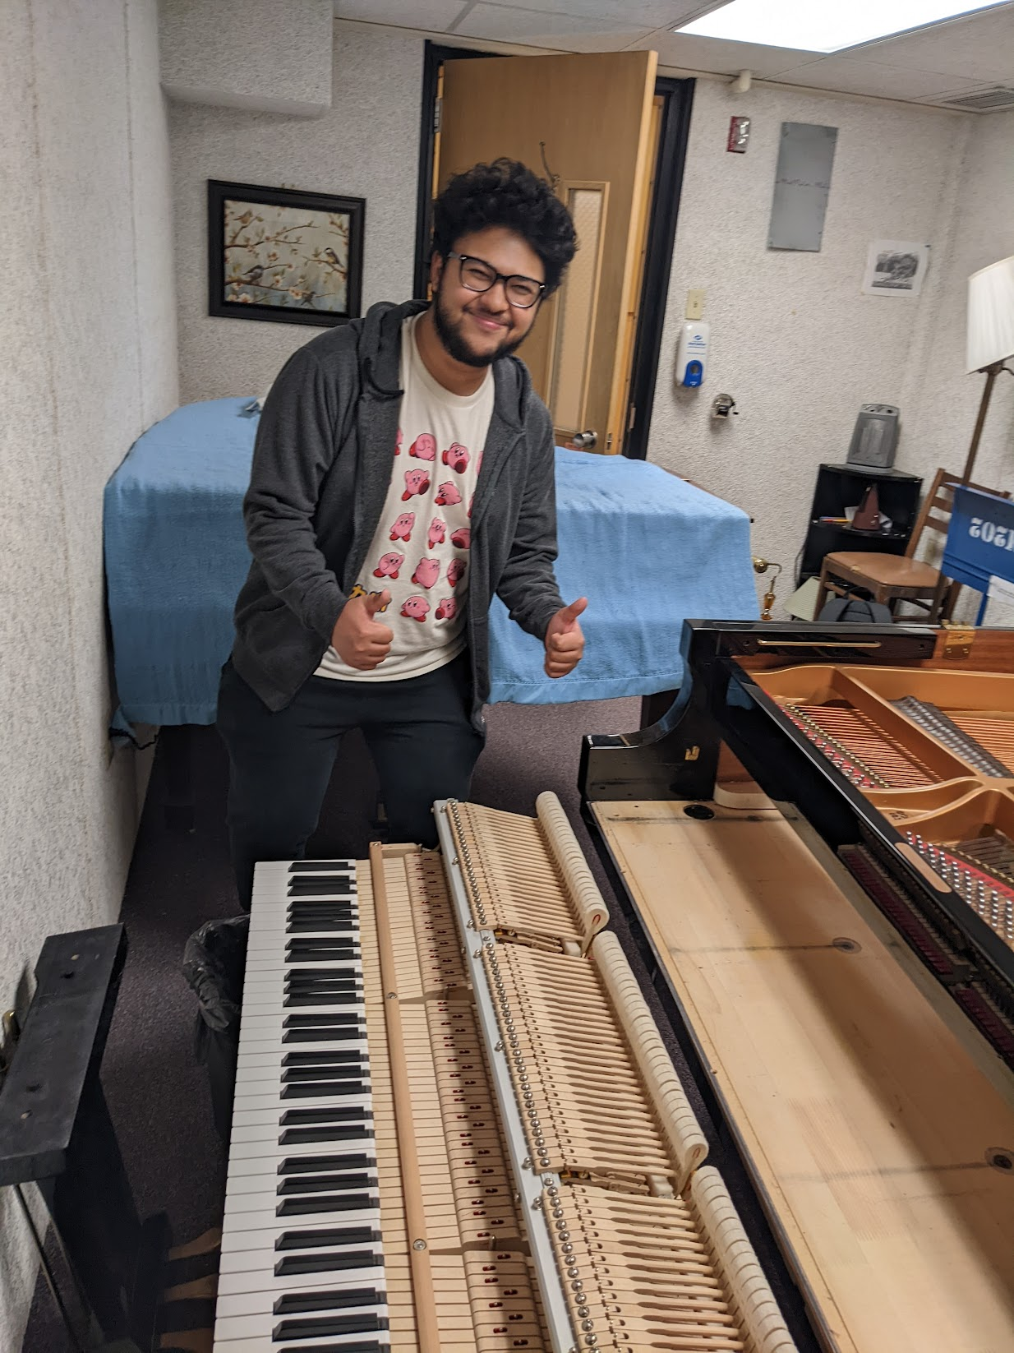
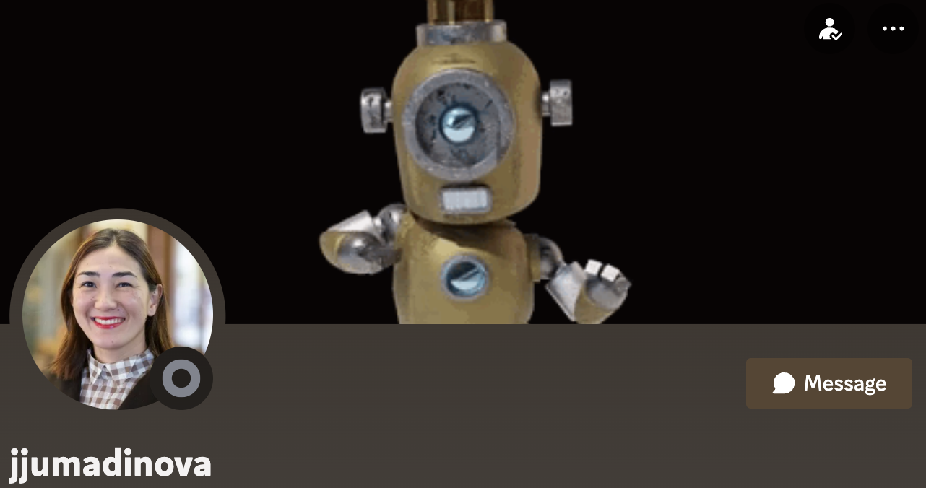
Guest Spotlight!

Slide 5
Course Overview

Slide 6
LS 591 - Computational Skills and Problem Solving
Course Overview
2 credits, pass/fail
This course is a hands-on, activity-based study group for developing skills related to computers and computational thinking
It is imperative to attend class because a majority of activities take place in class, collaboratively
There are only 5 meetings after today after Friday iTea

Slide 7
LS 591 - Computational Skills and Problem Solving
The benefits of participating include
reviewing or learning how to organize and find files on your computer
reviewing or learning tricks for troubleshooting computer problems
reviewing and practicing problem-solving skills
reviewing and practicing algebra-based logic
guaranteed slot in CMPSC 100 next semester
one extra homework token for CMPSC 100

Slide 8
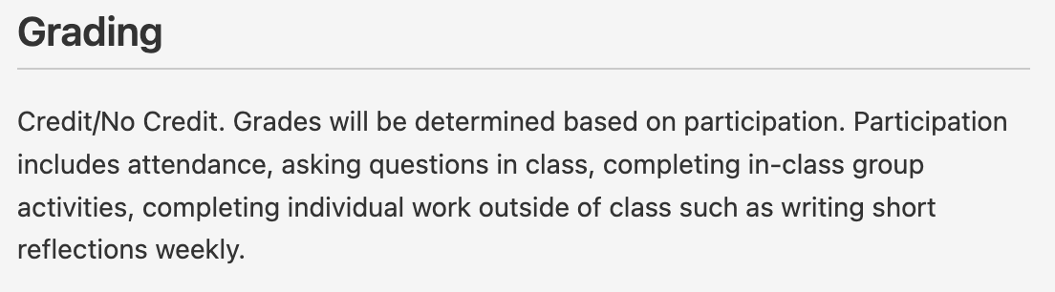
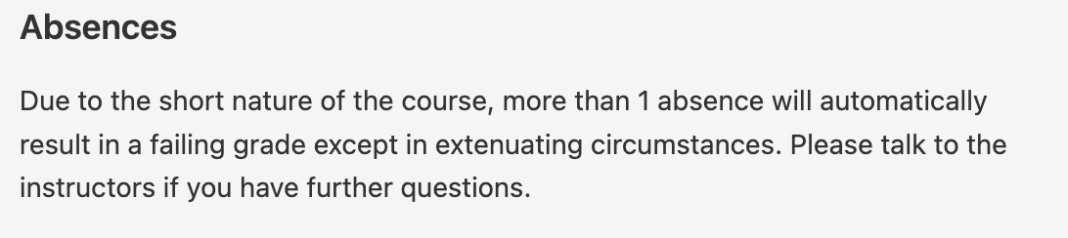
LS 591 - Computational Skills and Problem Solving
Check the Syllabus for detailed information on
Instructor office hours
Course Schedule
Policies

Slide 9
LS 591 - Computational Skills and Problem Solving
Activities for the course involve:
Estimating the unknowable
Filing video game characters
Typing songs + racing on Wikipedia
Learning about your future @ Blue & Gold Panel Talk!
Making PB&J sandwiches + following a campus scavenger hunt
Competing in a computational jeopardy for a prize

Slide 10
Departmental Values

Slide 11



WE ARE
TECHNICAL
WE ARE
ETHICAL
We aim to achieve competence and excellence in technical knowledge, its applications, and effects.
We make decisions rooted in the principles of equity and justice, focusing on the greater good of our communities.
WE ARE
INCLUSIVE
WE ARE
RESPONSIBLE
We provide an inclusive community environment which invites and celebrates diversity of experience, thought, and belief.
We honor commitments and take responsibility for our actions and outcomes.
OUR SHARED VALUES

Slide 12
Activity

Slide 13
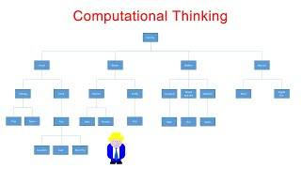
Approaching Problems with Computational Thinking
video url: https://www.youtubeeducation.com/watch?v=dHWmnayy8MY

Slide 14
Estimating the Unknowable
Group Activity
Navigate to Week1-ApproachingProblems/activity-estimation/ in GitHub

Slide 15
Acronym Challenge
Group Activity
Navigate to Week1-ApproachingProblems/activity-acronym/ in GitHub

Slide 16
Discussion
Strategies for estimation?
Strategies for problem solving?

Slide 17
Hope to see you next week!
Create bookmarks in your browser for the Discord + GitHub page for LS 591
https://discord.com/channels/877320365825749002/1277712021944537101
https://github.com/allegheny-college-ls-591-fall-2024
N.b. the 5pm deadline on Sept 10 (2024) for adding or dropping for 14-week and “Module A” 7-week courses for all students

